Slide 1
Understanding Backup and
Recovery Methods
Lesson 8

Slide 2
Objectives
Skill/Concept | Exam Objective | Objective Number
Understanding Local, Network, and Automated Backup Methods | Understand backup and recovery methods | 6.1
Restoring Previous Versions of Files and Folders | Understand backup and recovery methods | 6.1
Configuring System Recovery | Understand backup and recovery methods | 6.1

Slide 3
File Backup and Restore (1/3)
A backup is a properly secured copy of files and folders—and sometimes settings—usually saved in a compressed format.
A backup is created so you can restore the files and settings in the event of data loss from a hard disk failure, accidental erasure or disk formatting, or natural events.

Slide 4
File Backup and Restore (2/3)
Windows Backup uses the Backup and Restore utility to back up and recover files.
You can automatic backups by scheduling them to run daily, weekly, or monthly.
You can store backups on CD/DVD, to another internal disk, to an external drive, or to a network drive.

Slide 5
File Backup and Restore (3/3)
Windows 7 File Recovery was designed to protect a computer in the event of a system failure by storing data on another medium (hard drive, network folder, or CD/DVD).
It can also back up a system image of a computer, including applications.

Slide 6
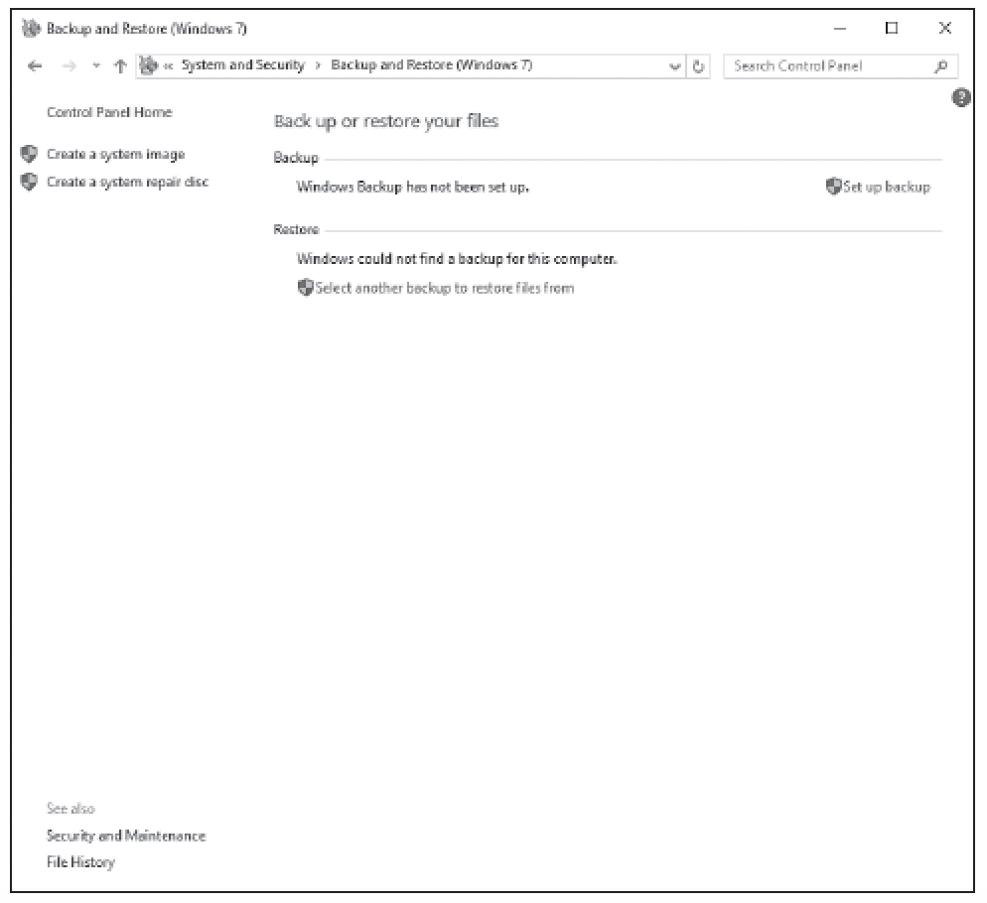
Backup and Restore (Windows 7)

Slide 7
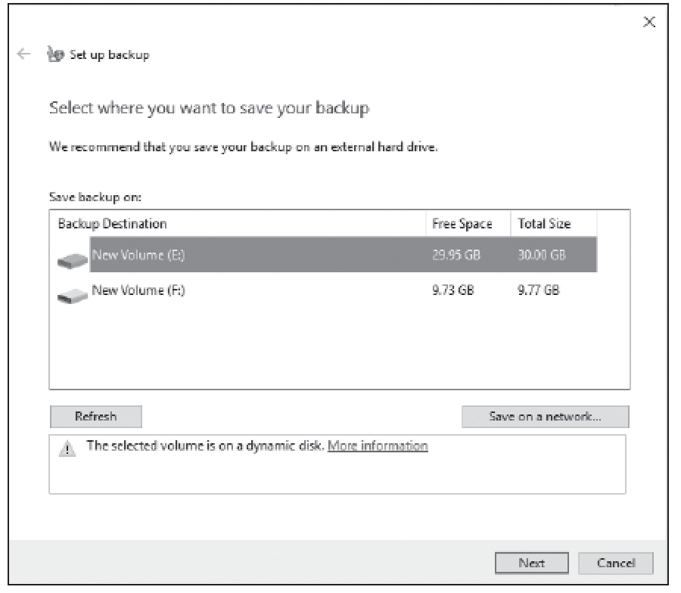
Setting a Location for the Backup

Slide 8
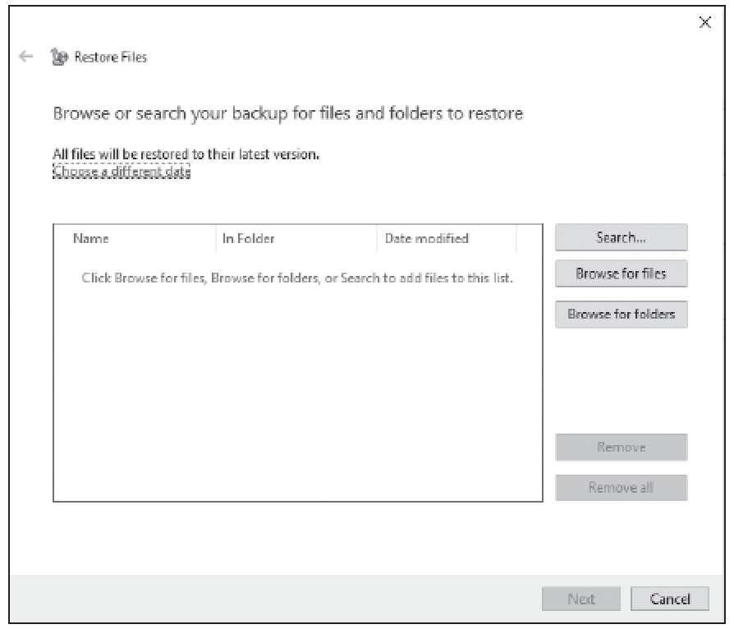
Restoring Files

Slide 9
Configuring System Recovery
There is no good time for a system to fail. But when it happens, you need to be ready.
And the best way to be ready is to know the available recovery options and what steps to take before the problem occurs.
However, the best method for system and data recovery is back up, back up, and back up some more.

Slide 10
Configuring a System Restore
Windows 10 System Restore saves information about drivers, registry settings, programs, and system files in the form of restore points for drives with system protection turned on.
A restore point is a representation of the state of a computer’s system files and settings.

Slide 11
Configuring a Windows 10 File Recovery Drive
A Windows 10 File Recovery drive can provide enough of a boot environment to get back into the system to begin the troubleshooting process.
It can be used to refresh or reset a computer, restore a computer to a previously created System Restore point, recover a Windows installation from a specific system image file, automatically fix startup problems, and perform advanced troubleshooting from the command prompt.

Slide 12
Configuring File History (1/2)
File History is a feature in Windows 10 that is designed to keep personal files safe.
It enables users who are not administrators to select an external drive or a folder on the network, and it automatically backs up and restores their personal files.

Slide 13
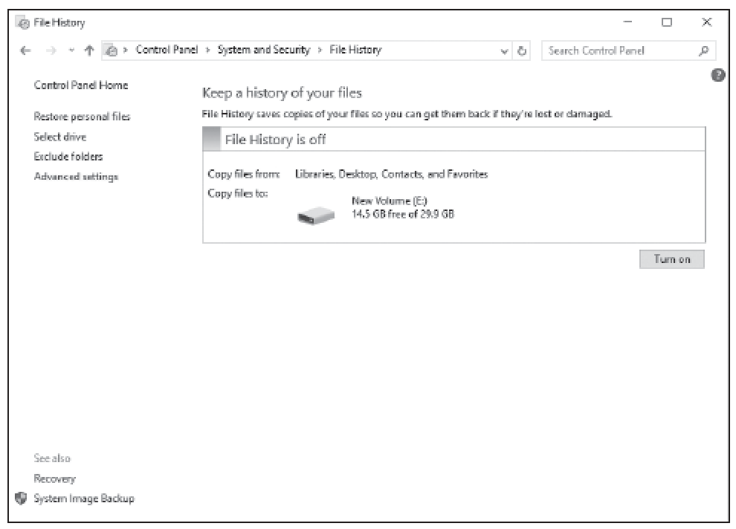
Configuring File History (2/2)

Slide 14
Performing Recovery Options Using Windows Recovery
The Windows Recovery Environment (Windows RE or WinRE) can be used to repair common causes of unbootable operating systems. It is based on the Windows Preinstallation Environment (Windows PE).

Slide 15
Summary (1/4)
A backup is a properly secured copy of files and folders—and sometimes settings—usually saved in a compressed format.
A backup is created so you can restore the files and settings in the event of data loss from a hard disk failure, accidental erasure or disk formatting, or natural events.

Slide 16
Summary (2/4)
Windows 7 File Recovery was designed to protect a computer in the event of a system failure by storing data on another medium (hard drive, network folder, or CD/DVD).
It can also back up a system image of a computer, including applications.
Windows 10 System Restore saves information about drivers, registry settings, programs, and system files in the form of restore points for drives with system protection turned on.

Slide 17
Summary (3/4)
A restore point is a representation of the state of a computer’s system files and settings.
A Windows 10 File Recovery drive can provide enough of a boot environment to get back into the system to begin the troubleshooting process.
It can be used to refresh or reset a computer, restore a computer to a previously created System Restore point, recover a Windows installation from a specific system image file, automatically fix startup problems, and perform advanced troubleshooting from the command prompt.

Slide 18
Summary (4/4)
File History is a feature in Windows 10 that is designed to keep personal files safe.
It enables users who are not administrators to select an external drive or a folder on the network, and it automatically backs up and restores their personal files.
The Windows Recovery Environment (Windows RE or WinRE) can be used to repair common causes of unbootable operating systems. It is based on the Windows Preinstallation Environment (Windows PE).

